Slide 1

Social value and the circular economy
Elin Brock
Elin Brock Ltd
Elin Brock Ltd
Elin.brock@gmail.com
07855 374634

Slide 2

The Well-being of Future Generations Act gives us the ambition, permission and legal obligation to improve our social, cultural, environmental and economic well-being.
Elin Brock Ltd
Elin.brock@gmail.com
07855 374634

Slide 3




Procurement is a fundamental vehicle to help achieve this !!!
‘If this money was being spent to buy things and improve the economic, social, environmental and cultural well-being of people and communities in Wales – imagine what would that mean? Wales has a great opportunity now to think about how and where to spend that money in the interests of future generations’
Sophie Howe, Future Generations Commissioner
Elin Brock Ltd
Elin.brock@gmail.com
07855 374634

Slide 4

The Can Do Way
Can Do Toolkit 1: Targeted Recruitment and Training (TR&T)
A CORE requirement in the contract is that the contractor shall commit to providing 52 person weeks of training per £1m spent.
Contractors have to demonstrate in their tender return how they will do this and their returns are scored and subsequently monitored as part of the contract
Elin Brock Ltd
Elin.brock@gmail.com
07855 374634

Slide 5


Can Do 2 – SME friendly procurement
Maximise supply chain opportunities within contracts
-Procurement through lots
Simplified PQQs and tender documents
Negotiate & appoint local suppliers – instruct bidders to use these appointed suppliers
Selection and award based on social and economic principles
Use of frameworks
Elin Brock Ltd
Elin.brock@gmail.com
07855 374634

Slide 6
So what’s happening now?
CAN DO DECLARATION:
Work with Welsh Government to agree a definition of social value that can be easily understood and widely adopted
Lobby to make a Can Do approach mandatory in all public funding and grant programmes over £1 million in value.
The ‘procurement flip’ – taking a long-term view of value and challenging the lowest price default position.
Elin Brock Ltd
Elin.brock@gmail.com
07855 374634

Slide 7
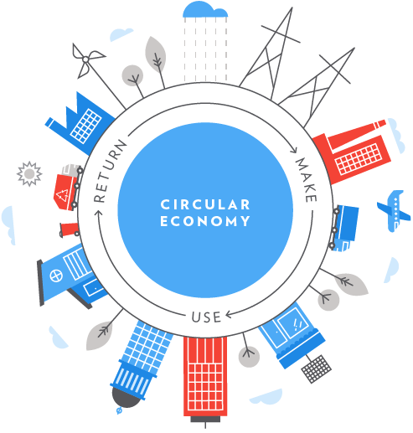
Circular economy
A circular economy is a systemic approach to economic development designed to benefit businesses, society, and the environment. In contrast to the ‘take-make-waste’ linear model, a circular economy is regenerative by design and aims to gradually decouple growth from the consumption of finite resources
Elin Brock Ltd
Elin.brock@gmail.com
07855 374634

Slide 8

It’s happening in housing!
Clarion Housing aims to:
Reduce waste generation
Maximise social value creation
Generate economic return on investment
Clarion Housing – aims to have circular principles written into every procurement contract for its 12 year £1bn regeneration project in Wimbledon
Choice of material – using bricks not concrete, because they can be reused
Set up take back schemes with bathroom and kitchen suppliers
Elin Brock Ltd
Elin.brock@gmail.com
07855 374634
Notes:
Circular economy strategy

Slide 9

Accord Group – building 12 virtually plastic-free homes
removing plastic from the kitchens, windows and bathrooms to avoid generating plastic waste
3 sector partnership delivering void clearances in Glasgow to re-use 80% of appliances and furniture left in voids
Elin Brock Ltd
Elin.brock@gmail.com
07855 374634

Slide 10
So what can your organisation do?
Undertake a Social Value Health Check
Social Value Recharge
Develop the framework / strategy with your communities and partners
Elin Brock Ltd
Elin.brock@gmail.com
07855 374634

